Slide 1

Three issues
Secularisation as partner
Changes of paradigm in history
Strategy for the church

Slide 2

Secularisation: Faith as a personal choice
Consequences for the churches:
1. Emphasis on personal choices (minority churches)
2. Personal choices are hidden (influential churches)
3. Believers with no ungoing relation to church
4. Anti-believers

Slide 3

Changes of paradigm in history
Abraham: personal faith
Jewish tribes: liturgical faith
Israel as nation: Jerusalem oriented
Babel: synagogue faith
Christ: new groups beside the synagogue
Constantine: dominant faith

Slide 4
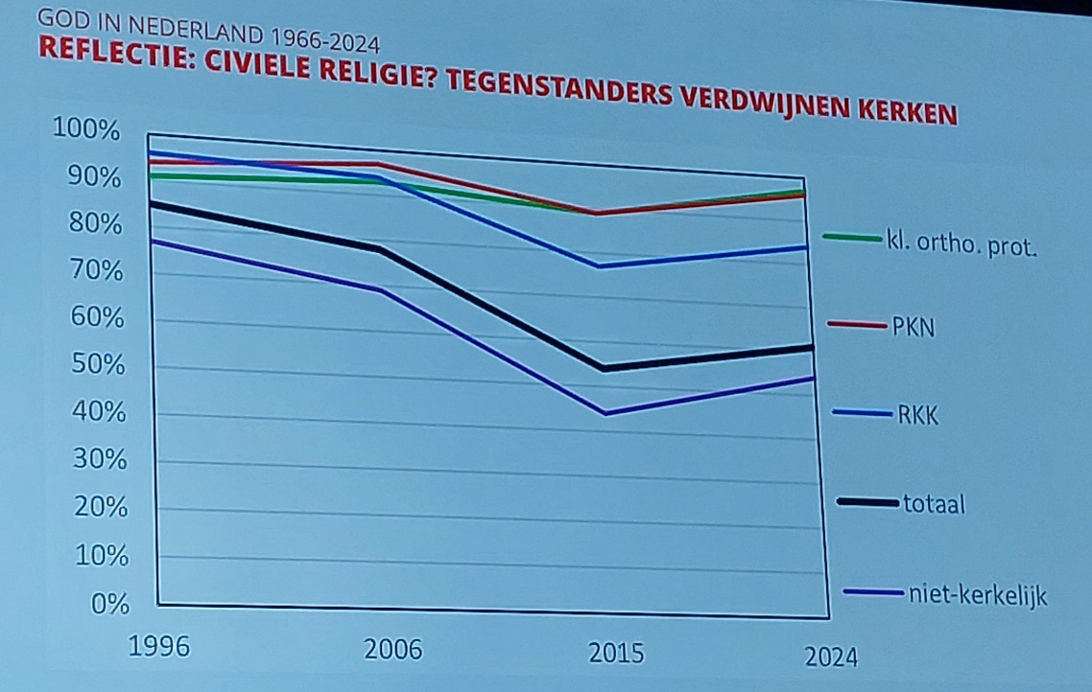
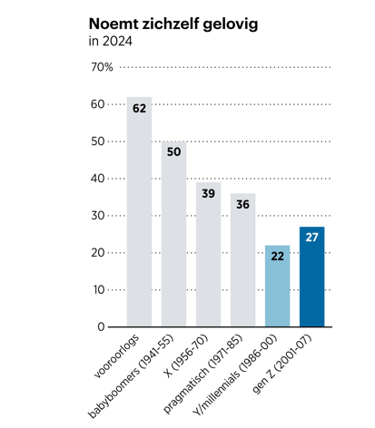
Dutch statistics

Slide 5

Strategy for the church
Pioneering places
Distinctive membership
Church buildings also for cultural purposes
Being visible in texts and diaconial activities
Public discussions (organising tables)
Speaking of God in a way secularizes people understand and appreciate

Slide 6
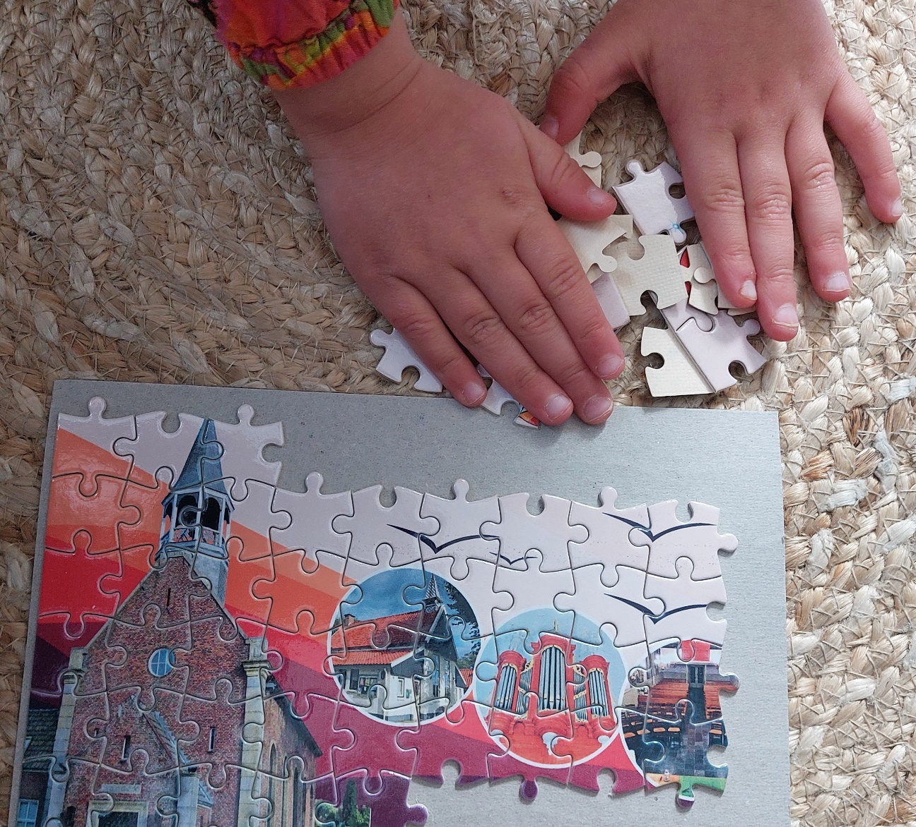
Summary
Give secularization a place in faith
Translate transition of faith into ecclesiology
Elaborate faith into ecumenism, apostolate, diaconia, church design and mediation role

