Slide 1



1. Secularization as partner 2. Transition lines in the Bible 3. Strategy for the church

Slide 2

Secularization
Definition: Faith as a personal choice
By definition not based on authority of a church
Enlightenment created a new situation, a transition

Slide 3
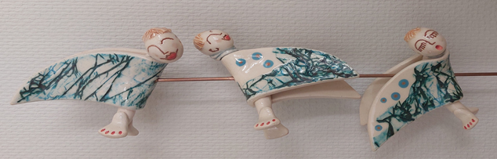
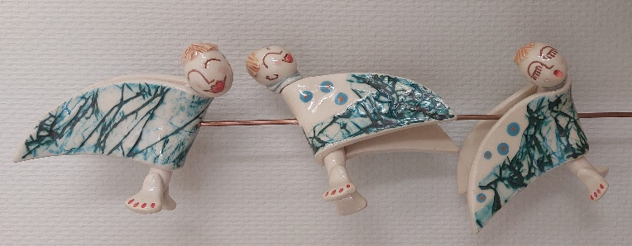
How to react: 1. Minority churches: personal choices in faith 2. Majority churches: transition is hidden 3. Independent believers 4. Independent anti-believers

Slide 4

Transition in the Bible
Mesopotamia-Abraham: personal faith
Patriarchs-Desert people: liturgical faith
Desert people-Jerusalem: central faith
Jerusalem-Babel: synagogue faith
Revelation of Christ: confessional faith
Transition in the early church: a. Synagogue-church: distinctive faith
b. Jewish-pagan church: pluralistic faith
c. Minority-majority church: dominant faith

Slide 5

What remains:
Faithfulness of God
Accommodation of God

Slide 6
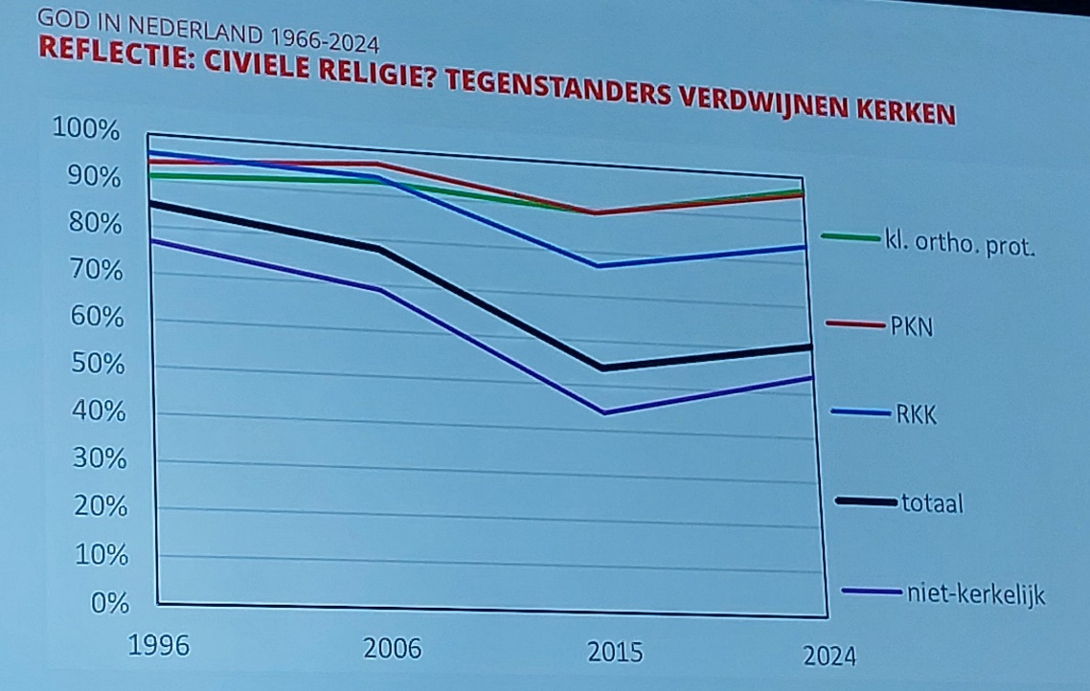
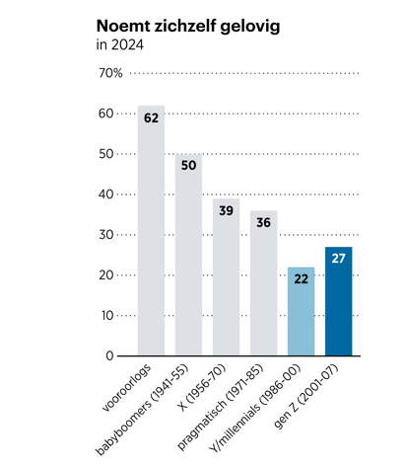
Strategy for the church Statistics show room for:
Focus on independent believers
Old strategy: focus on core believers So shift from dogmatics towards life
* expecatitions of secular people * interest generation-Z (2001-2007)

Slide 7

How do churches with faith respond?
Through pioneering places
Through distinctive card indexes
By using church buildings for cultural purposes
Through public discussions (diverse tables)
Through diaconia

Slide 8

Summary: 1. Give secularization a place in faith 2. Translate transition of faith into ecclesiology 3. Elaborate faith into apostolate and diaconia

